Slide 1

SAP BTP ABAP on Cloud / RAP Training
DAY-7
Anubhav Oberoy
www.AnubhavTrainings.com
Follow excellence with sheer passion

Slide 2


DISCLAIMER
The training content and delivery of this presentation is confidential, and cannot be recorded, or copied and distributed to any third party, without the written consent of Anubhav Trainings

Slide 3

01
SQL Script
02
AMDP
03
Table Functions
04
Scalar functions
Notes:
https://pixabay.com/photos/san-francisco-transamerica-pyramid-1633203/

Slide 4
SQL Scripting
SQL Script is a programming language used inside databases, which is an advance version of plain SQL. It is the last option to improve performance of our applications and achieve code to data paradigm by code-push-down.
Why SQL Script
In the past we used to Fetch the data in ABAP, Loop over the data, Process the data and then write data back to database. We want to fully leverage the computational powers of SAP HANA, hence using SQL script we can achieve it. All our data intensive logic which we write using ABAP can now be pushed down to HANA DB using SQL Script.
https://help.sap.com/docs/SAP_HANA_PLATFORM?locale=en-US&task=use_task
SQL Script is not case-sensitive and every line ends with semi-colon (;)
We can use the code constructs like IF, ELSE, LOOP, FOR, WHILE, RAISE
When we create variables, they are assigned with null value
The = is comparison operator and := is the assignment operator. We can assign the value to variable using the var = val but when we use the variable in the code, we use value of (:) operator to use a variable.
When we assign the a query to a variable, the variable will allocate memory automatically
www.anubhavtrainings.com

Slide 5
AMDP – ABAP managed Data procedure
Sometimes, the CDS performance is not suitable for our use case and we need more complex technique to process our data deep into database to get best performance using code-to-data paradigm
We want to use database specific features
CDS views have limitations
CDS views cannot be debugged
Overcome the disadvantages of CDS where we need to branch output of one Queries to another
We cannot write imperative logic using CDS – IF, ELSE, LOOP, WHITE, EXCEPTION etc.
CDS also does a strict type check while writing joins and associations
An AMDP is:
A static function in ABAP class marked with marker interface IF_AMDP_MARKER_HDB
The function can only have Import and Export parameters and all parameters must be passed by value
We cannot use complex data types (deep)
Any DB table which we plan to use with AMDP should be added to using clause
When we run the AMDP, A procedure gets created inside the DB
All the code will be written in SQL scripting programming language which will be pushed into the database
Since we directly execute AMDP in DB, there is no automatic client handling
www.anubhavtrainings.com

Slide 6



What is AMDP?
AMDP stands for ABAP Managed Data Procedure, it is one the best way to integrate the SQL Script code in SAP ABAP system.
An AMDP is a ABAP class which contains SQL Script code
It allows to write, test, debug, manage SQL Script code direct via ADT along with ABAP layer
You don’t need to login to HANA DB with HANA Studio
An AMDP is managed in ABAP layer hence it is transported to Q and P via ABAP transport
Debugging of SQL Script is also done in ABAP layer
Its top-down approach to push down logic to DB level
AMDP
mutation
IF_AMDP_MARKER_HDB
ABAP class
8
www.anubhavtrainings.com

Slide 7
Technicality
You can only create an AMDP if your ABAP system is running on top of HANA Database
It’s a method in the mutated ABAP class. The class can contain multiple AMDP functions
You can also have normal ABAP functions in same class as well
But the merging of ABAP code with SQL Script code is not allowed.
You cannot call any ABAP statements like calling FM, printing data, calling another class etc.
We can do design time syntax check on SQL script code and debug also
The only tool used to make AMDP is ADT (not SAPGUI)
The function must have the importing and exporting params only, returning is not allowed
All the parameters must be passed by value only
We cannot use nested tables, structures as data types of AMDP signature
Its static function of the class which can be called by classname=>function_name
AMDP function will follow a special syntax to declare
Any DB table which we want to use inside AMDP must be added as using clause in function impl.
AMDP is transported to Q and P using ABAP transport
Only SQL script language is supported
When we create AMDP nothing happens in HANA, when we call AMDP first time, an AMDP a procedure gets created inside HANA DB
The AMDP creates the procedure in ABAP schema (SAPHANADB) so we can only use those tables
9
www.anubhavtrainings.com

Slide 8
CDS Table function
Bridge the gap between CDS and AMDP, A CDS table function
Defines the skeleton of the data which we want from DB
When it executes, it actually calls SQL Script code
It creates a FUNCTION database unlike AMDP creates a PROCEDURE in database
The CDS table function, can later be used to build view on view or can be used in OTHER CDS views also as JOIN/Agg
Plain CDS functions:
https://help.sap.com/doc/abapdocu_752_index_htm/7.52/en-US/abencds_f1_builtin_functions.htm
www.anubhavtrainings.com

Slide 9
CDS Scalar Function
A scalar UDF in hana which returns exactly one value.
CDS entity
Myfunc() as result
Scalar Function Definition
Class
Function code()
coda
Scalar function implementation Reference
8
www.anubhavtrainings.com

Slide 10




Challenges in ABAP development
UI
Common needs
Create application logic
Insert, update, delete, validate, select data
Perform validations
Check customizing
Handle locks
Create A/c documents
Manage Documents
Application Code
I, U, D, S, V
Search Documents
Validate before save
Alex, ABAP Developer,
SAP FICO
UI
Challenges
Thinks differently
Adapt application code
High maintenance
No standardization
Different coding practices
Lack of standard
Create Sales Orders
Manage Sales Orders
Application Code
I, U, D, S, V
Search/Filter Sales Order
Compute Sales total
Stella, ABAP Developer,
SAP SD
www.anubhavtrainings.com

Slide 11
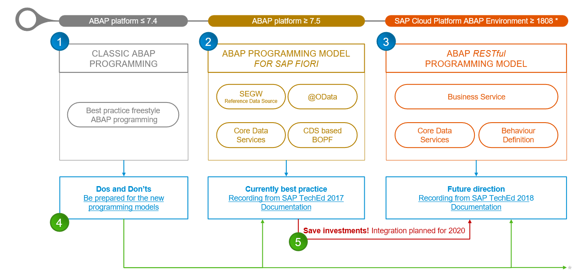
Evolution of ABAP Programming Model
www.anubhavtrainings.com

Slide 12
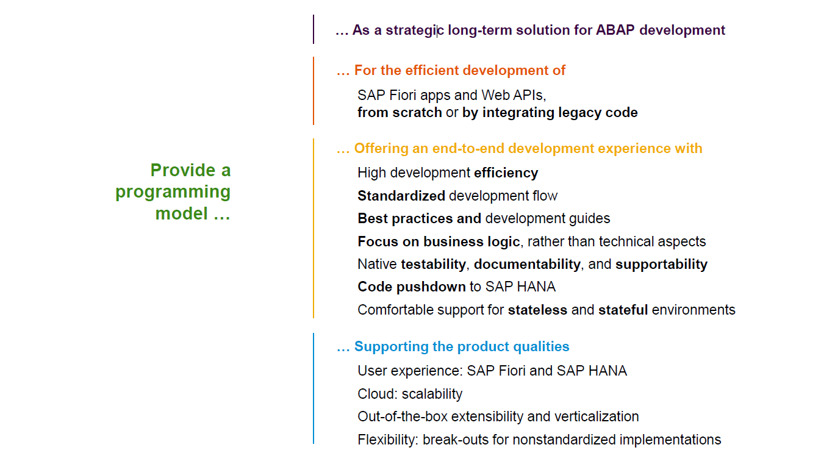
Restful ABAP Programming
www.anubhavtrainings.com

Slide 13
Restful ABAP Programming
The ABAP RAP (Restful Application Programming) Model defines the architecture for efficient application development for HANA optimized ABAP applications. It supports development of
Greenfield applications – A completely new application from scratch
Brownfield applications – A new/extension of application using OLD code
It is based on proven technologies and frameworks such as CDS entities to define semantically rich data model and service model infrastructure for creating and binding OData services for different use cases e.g. Fiori App, WebAPI, InA
www.anubhavtrainings.com

Slide 14
www.anubhavtrainings.com
Thank You
End of Day 7
www.anubhavtrainings.com

Slide 15


We’re committed to empower you to be
#FutureReady
through powerful training solutions.
We build the workforce of the future.
250+
Corporate Clients
30,000+
Learners Trained
25000+
Learners Placed
FREE WEBINARS
Sign up for free webinars with industry experts every fortnight!
Enroll Now!
Contact us today!
https://anubhavtrainings.com

